Slide 1

Open Licenses for Data, Code and Software for Data Stewards
Ver 1.0
Notes:
How to use these slides. Please refer to the trainer notes for complete guidande and speakernotes. The slide deck is very long! This is because we dive down into the complexities of licensing. Please feel free to “pick and mix” the slides so the scope fits your training purposes and audience.

Slide 2
Welcome to the Learning Path!
•Use welcoming and inclusive language
•Be respectful of different viewpoints and experiences
•Gracefully accept constructive criticism
•Focus on what is best for the learning session
•Show courtesy and respect towards other learners and instructors
Notes:
Introduction and housekeeping
Code of conduct (as an animation)
Learning objectives
Schedule
Introduction of trainers and helpers
Our expectations for the session - dependent on the slides the trainer has chosen to use (read more in the trainer notes)
Ice-breaker

Slide 3
Learning objectives
After completing this unit you will be able to:
Explain the different types of licenses that can be applied to FAIR research outputs in accordance with regulations, policies and other legal requirements.
Apply (multiple) licenses appropriately during the development and publication of a research output
Argue for the choice of one or more appropriate licenses to research output and identify the importance of creating machine-readable rights statements and applying the statement to a data package
Engage in the research process and influence the research process to accommodate for FAIR data

Slide 4
Schedule
Welcome! | 10 mins
Unit 1: Why you shouldn’t license research data | 10 mins
Exercise: Arguments for licensing data | 10 mins
Unit 2: Applying licenses to FAIR research output – an abstract view | 20 mins
Exercise: Assessment criteria | 10 mins
Break | 5 mins
Unit 3: Applying licences in real-life | 20 mins
Exercise: | 10 mins
Wrapping up and evaluation | 10 mins

Slide 5
Ice-breaker
Get to know each other in smaller groups.
When in the breakout room, take rounds of introductions (30 seconds). Tell the others:
What’s your name?
Which organization do you come from?
What’s your research area (in 5 words)?
Finally, find a course buddy. All buddies will peer review each others’ answers to the exercises. Make sure you exchange email addresses!

Slide 6
Unit 1: Why you shouldn’t license your research output
Notes:
Aim: Advocate for the uses and advantages of licensing.
This topic will cover the hypotheticals:
Available data is still usable to others without a license, so why bother?1.
My data shouldn’t be available (yes, they should, and otherwise do think or usage rights in a longer perspective; FAIR where access is restricted)2.
Nobodys data gets reused or gets credit anyways (hopefully to be proved wrong with insights into the fact that this happens)3.
I’ll just do it, if somebody requests to get access to my data.
I can be blamed, if somebody misuses my data, or make false assumptions.
My collaborators thinks I’m making things way to complicated by licensing data.Provocation: Discuss why you should not apply licenses to research data what is the purpose of licenses and their relation to FAIR principles
Discuss the ability to keep data separated during the research workflow, to allow for publication and dissimination of parts of data, or take actions to split data into multiple subparts of which some can be made available and licensed, or techniques like anonymisation that allows for making data available.
Be able to inform about options of FAIRness, when data cannot be made available under current open licenses.

Slide 7
Unit 1: Why you shouldn’t license your research output
Let's keep talking !
Have you ever been in or witnessed a situation in which a researcher :
Doesn't know that it is preferable to apply licenses to its data?
Who is reluctant to use licenses?
Who thinks that using a license for their data is useless or a waste of time?
Notes:
After the ice breaker part, the aim is to continue the discussion. To introduce the unit we can start by asking the students the questions above. In this way, they can share any experiences they may have had with people who were reluctant to use licences for research data.

Slide 8


How to advocate for the uses and advantages of licensing
Available data is still usable to others without a license, so why bother?
Releasing data without making the terms of use clear can be confusing and counterproductive, as it may deter potential users from using and citing the data.
Nobody’s data gets reused or gets credit anyway
‘
In fact, choosing a license can be made quite straightforward, by using tools like choosealicense.com, and also looking up your institution’s existing licensing policy
My collaborators think I’m making things way too complicated by licensing data.
Licensing data can be intimidating. There are many licenses available, and choosing and applying them can seem complicated. Further, the benefit to researchers is not always clear.
Licensing is an important aspect of practising Open Science. By applying licenses to your outputs, you remove any ambiguity over what others can and can't do with your work.
But
Sources : 1 - 2 - 3 - 4 - 5
image source - Pixabay CC0

Slide 9
How to advocate for the uses and advantages of licensing
Most jurisdictions throughout the world have some provision for intellectual property rights that govern how and under what conditions information objects can be shared and reused.
My data doesn’t need to be available
I can be blamed, if somebody misuses my data, or make false assumptions.
A lot of research is also publicly funded, and applying a license, especially an open license, should help make your research ouptuts openly available..
An area of concern for many researchers is whether they will incur liability for re-use and re-purposing of their data. For example, if research data contains data relating to architecture or construction, could the researcher be liable if that data was re- purposed to construct a building that later collapsed?
Standard licences usually offer a clause about limitations and disclaimers, which make it clear that the research data is shared ‘as is’ and that the original researcher is not responsible for the outcomes of re-use and re-purposing
With the appropriate license your’re avoiding unpleasant situations surrounding reuse of data.
Sources : 1 - 2 - 3 - 4 - 5
image source - Pixabay CC0

Slide 10
Takeaways
The choosing to apply a license is a determinant stage in the process of diffusing a research product. This choice has concrete consequences and should not be taken lightly.
Th
When faced with a reluctance to use a license, it is necessary to insist that it is not a constraint but a benefit to the researcher themself and for their scientific community (protection of one’s rights, more citations, more re-use).

Slide 11
Learning Activity (5-10 minutes)
Now it’s your turn :
What advice would you give to a researcher who doesn't want to use licenses?
How might licensing research data be advantageous to a researcher?
Choose one of the two situations and try to prepare 2 or 3 arguments in which you advocate for the use of licenses on research data.
Let’s discuss this together !

Slide 12
Unit 2: What to consider before applying licenses to research outputs

Slide 13
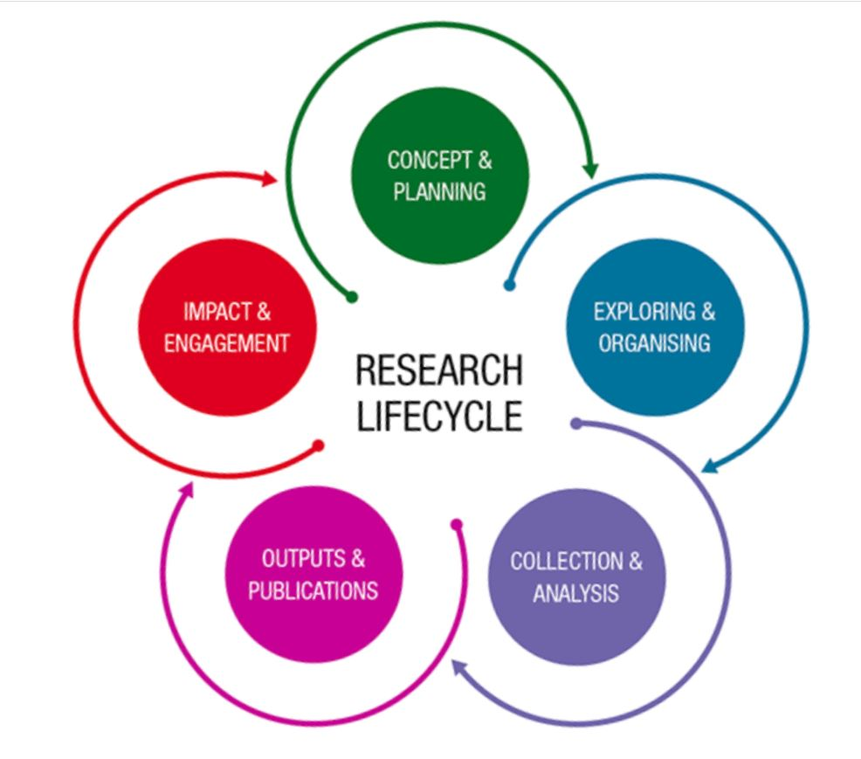
Let’s consider the research life cycle
Licensing is part of all processes in the research life cycle.
It should be prepared for at the beginning and iteratively evaluated throughout the research project.
Source: Monash University

Slide 14

Checklist before sharing data and applying a license
Evaluate and assess:
Funder requirements
Journal requirements
Ethical concerns
Personal data
Contractual obligations
Reduced novelty of findings
Ability to commercialize
Copyright/license infringement
Dual use
Right to assign a license
+ national strategy and rules
+ institutional ambitions/policies on FAIR data
+ agreements in data management plans or the like
The sum determines the ability to share and license research output like data and code.
Illustration: janjf93

Slide 15
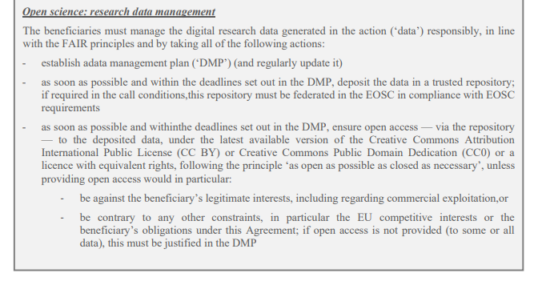
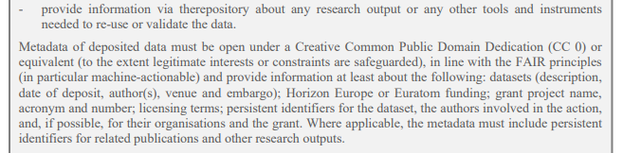
Assessment of ... Funder requirements #1
What does it look like?
Source: EC Annotated Grant Agreement

Slide 16
Assessment of ... Funder requirements #2
Some funders will ask you to openly share as many research outputs as possible - or to make them at least FAIR.
Some funders will ask for a detailed data management plan outlining how you will share and license research outputs.
Mitigation strategies for sharing and applying a license
Aim for FAIRification and agree how to do this
Discuss the funder requirements with project partners, and use a DMP to document your agreements in the preparation phase and during the project

Slide 17
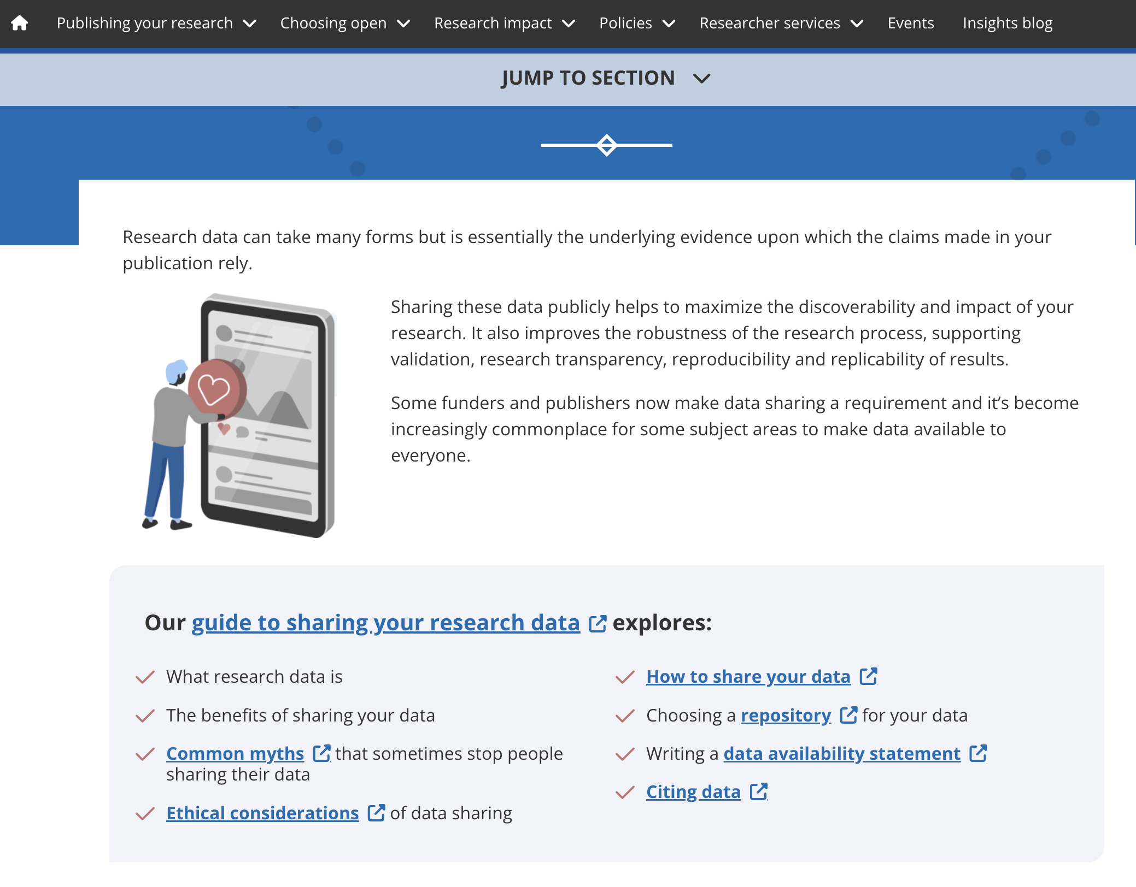
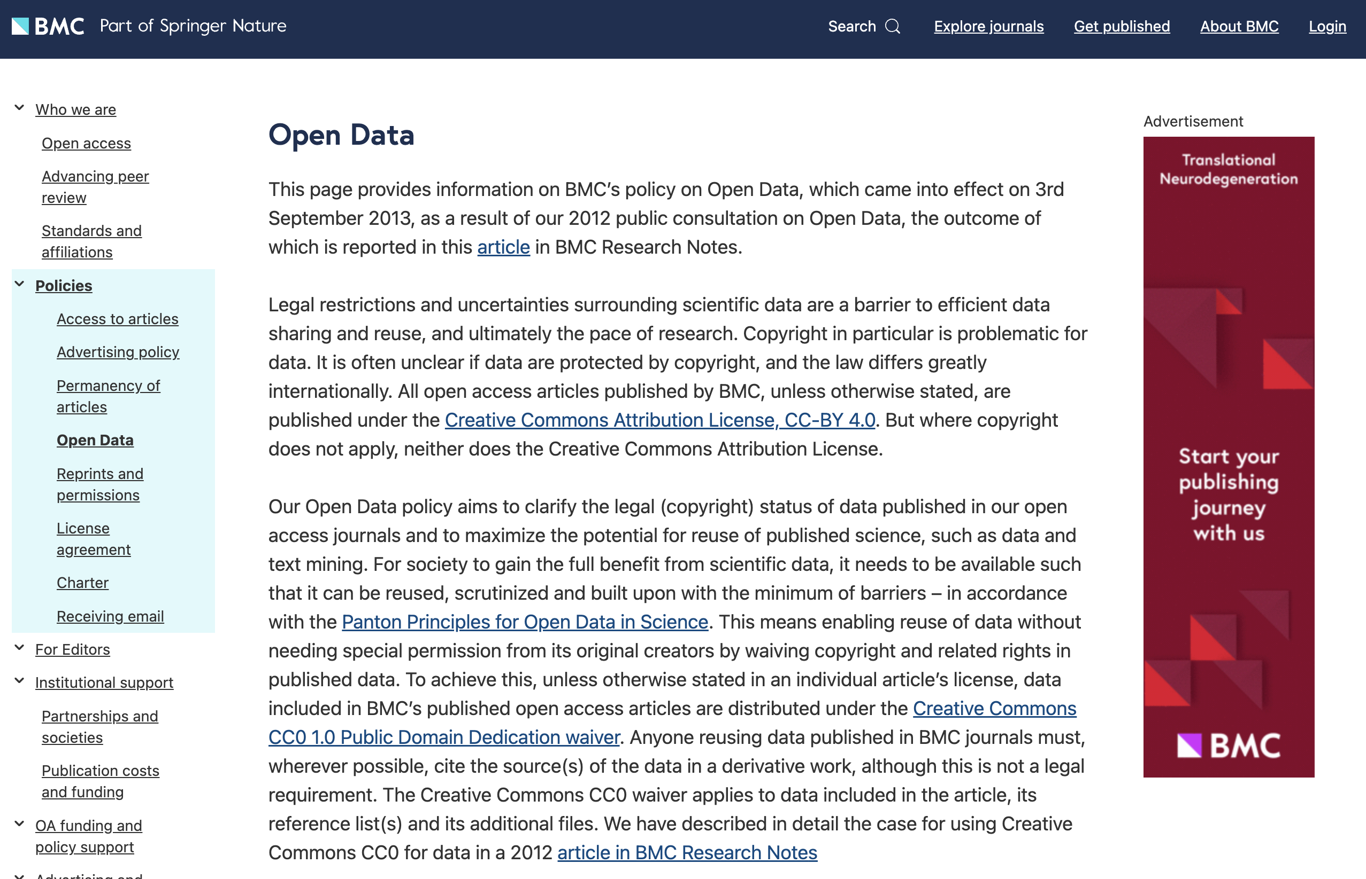
Assessment of ... Journal requirements
Source: Taylor and Francis Data Policies
What does it look like?
Source: BMC on open data

Slide 18
Assessment of ... Journal requirements #2
Many journals and/or publishers describe their expectations or requirements in policies on data availability, data sharing, or data openness.
Researchers are often asked to write a data availability statement.
Possible mitigation strategies for sharing and applying a license
Match the journal requirements with ability to share and license, and consider publishing a subset of data, anonymise personal data, etc.
Switch publication strategy towards other journals

Slide 19
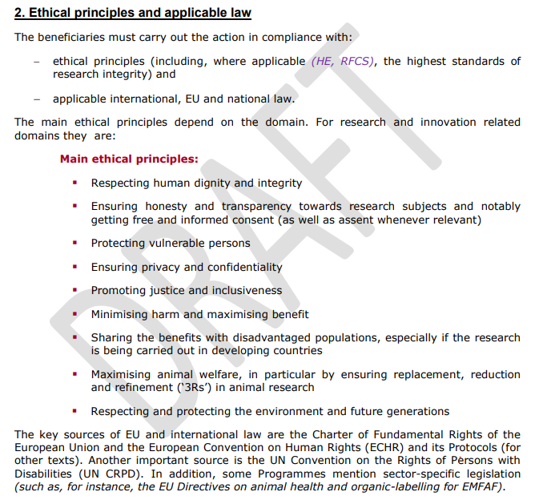
Assessment of ... Ethical concerns # 1
What does it look like?
Source: EC Annotated Grant Agreement

Slide 20
Assessment of ... Ethical concerns #2
Funders, authorities, institutions, journals etc. expect ethical research conduct.
Ethical research conduct often presupposes an assessment of how the research will impact human participants, animals, plants, ecosystems etc.
Possible mitigation strategies for sharing and applying a license
Choose a subset of the data for publication and/or de-identify data
Obtain proper informed consent that allows for data sharing

Slide 21

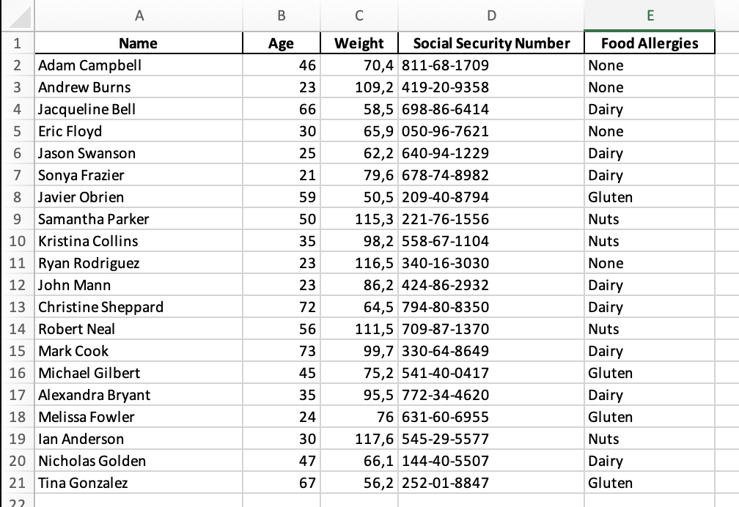
Assessment of ... Personal data #1
What does it look like?
Generated with ChatGPT4. A photorealistic image of a diverse group of five individuals. There is a South Asian woman with long, black hair and a bright red dress. Next to her stands a Caucasian man with short, blonde hair, wearing a blue suit. Beside him, a Black woman with curly hair and a green blouse is depicted. There's also a Hispanic man with a shaved head and a gray t-shirt. Finally, a Middle-Eastern woman with brown, wavy hair and a purple top completes the group. Each person is smiling and standing in a friendly, relaxed pose.
Random generated data by ChatGPT4. Any match is coincidental.

Slide 22
Assessment of ... Personal data #2
“‘personal data’ means any information relating to an identified or identifiable natural person (‘data subject’); an identifiable natural person is one who can be identified, directly or indirectly, in particular by reference to an identifier such as a name, an identification number, location data, an online identifier or to one or more factors specific to the physical, physiological, genetic, mental, economic, cultural or social identity of that natural person”
https://data.europa.eu/en/publications/datastories/protecting-data-and-opening-data
Possible mitigation strategies for sharing and applying a license
Obtain proper informed consent that allows for data sharing
Anonymise personal data
Consider only making metadata openly available

Slide 23
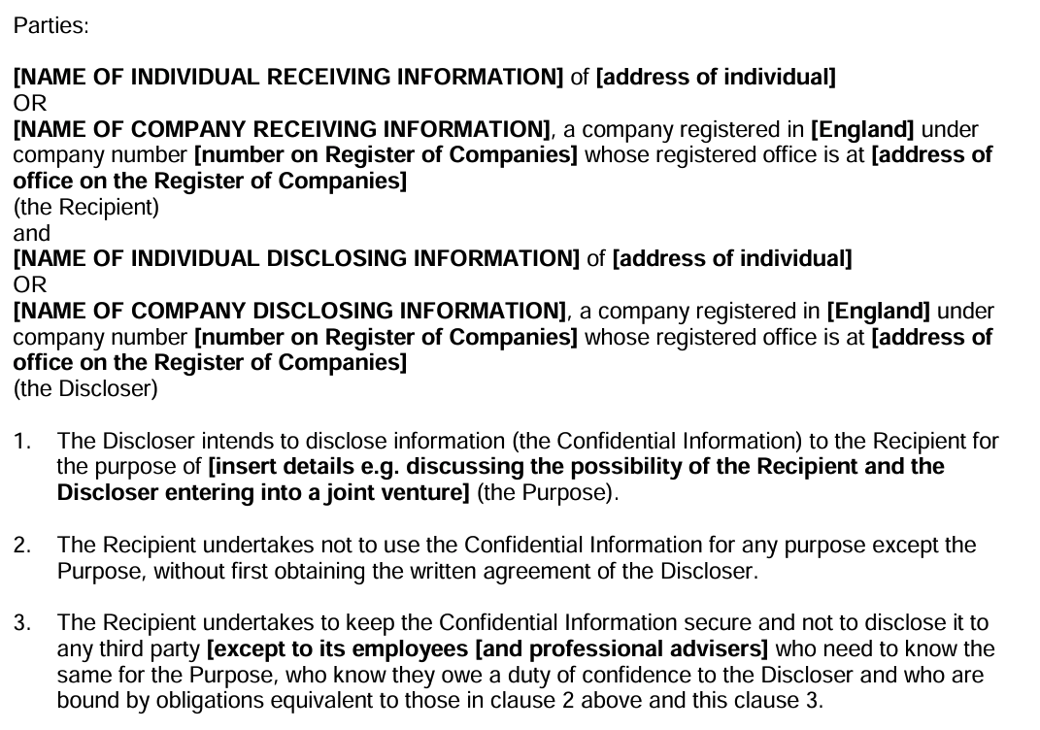
Assessment of ... Contractual obligations #1
What does it look like?
Source: Example of a NDA from gov.uk

Slide 24
Assessment of ... Contractual obligations #2
Some contracts, especially non-disclosure agreements (NDAs), limit your ability to make data and/code openly available or explicitly require access restrictions.
Other contracts define usage rights in a way that limits the ability to apply a license or specifies who should be attributed in the license.
Possible mitigation strategies for sharing and applying a license
Revisit the agreement and create an addendum for sharing and licensing
Consider making only a subset of the data available or applying multiple licenses with different metadata to different subsets
Consider making only metadata openly available and define access restrictions and an agreement for data reuse

Slide 25
Assessment of ... Risking reduced novelty of findings #1
Example of a letter from a journal to an author.
Subject: Decision on Manuscript ID [XXXXX] - [Title of Your Article]
Thank you for submitting your manuscript entitled "[Title of Your Article]" to [Journal Name]. We appreciate the opportunity to consider your work for publication. After careful evaluation by our editorial team and external reviewers, we regret to inform you that we are unable to accept your manuscript for publication in [Journal Name].
The peer review process is integral to maintaining the quality and integrity of the work published in our journal. Based on the feedback received, the primary reason for our decision is the lack of sufficient novelty in the research presented. While your study is methodologically sound, the reviewers noted that the findings do not significantly advance the current understanding in the field or offer new or compelling insights. In our commitment to publishing work that provides notable contributions and advances to the field, we must be stringent in our criteria for novelty and significance.
What does it look like?
At submission
Criteria for publication
The criteria for publication of scientific papers (Articles) in Nature are that they:
report original scientific research (the main results and conclusions must not have been published or submitted elsewhere)
are of outstanding scientific importance
reach a conclusion of interest to an interdisciplinary readership.
Source: Nature Editorial Guidelines

Slide 26
Assessment of ... Risking reduced novelty of findings #2
Consider if making data and/or code openly available will ...
enable others to reach the same conclusions before you (scooping)?
make your related work (e.g. an article) seem less original?
Possible mitigation strategies for sharing and applying a license
Consider the timing of making data and/or code openly available.
Share and license only subsets of the data early in the research project.

Slide 27
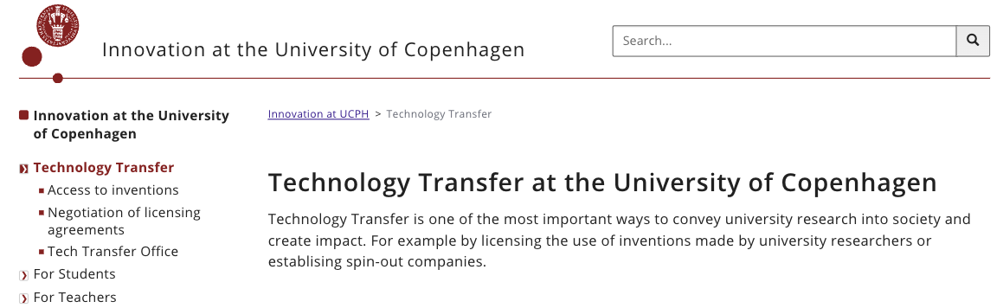
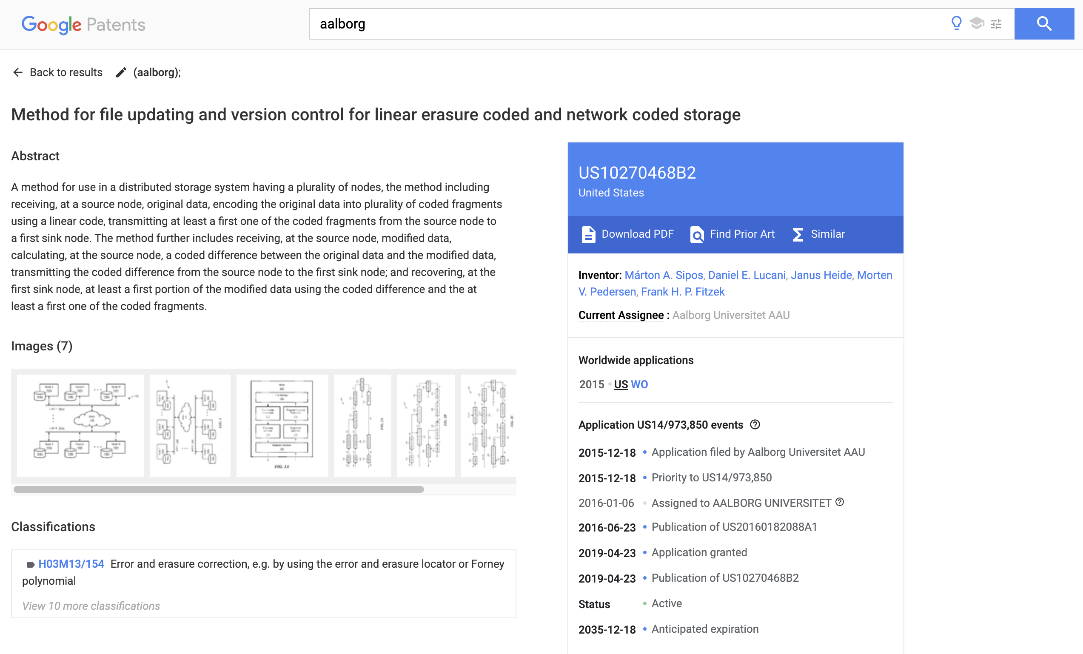
Assessment of ... Ability to commercialize #1
What does it look like?
Example of TTO office. Source: University of Copenhagen TTO
Source: Google Patents

Slide 28
Assessment of ... Ability to commercialize #2
Consider if making data and/or code openly available will ...
hinder the ability to pursue a commercialization potential or obtaining a patent.
Possible mitigation strategies for sharing and applying a license
Consider the timing of making data and/or code available
Seek legal advise early on to assess commercialization potential

Slide 29

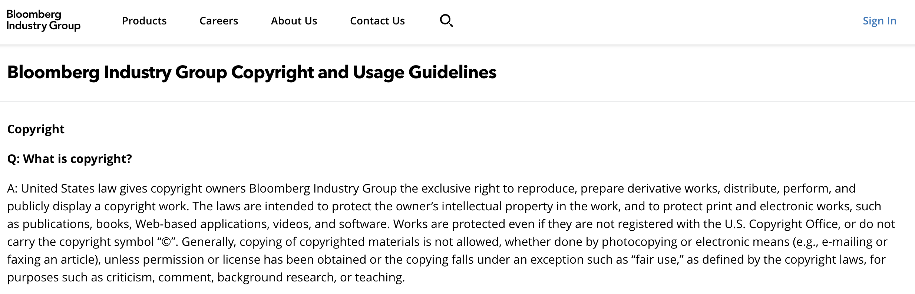
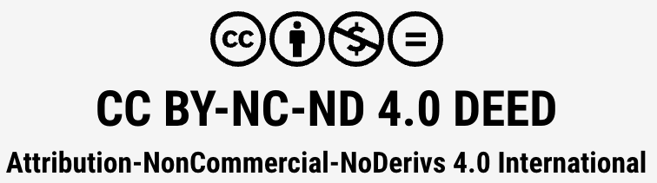
Assessment of ... Copyright/license infringement #1
What does it look like?
Generated image with ChatGPT.
Illustrates example of workshop outputs from citizen science project
https://www.bloombergindustry.com/copyright-and-usage-guidelines-copyright/

Slide 30
Assessment of ... Copyright/license infringement #2
Some data is protected by copyright and, therefore, you cannot share or license it.
Some data is shared under a restrictive license that prevents most forms of reuse and sharing.
Possible mitigation strategies for sharing and applying a license
Agree on and assign an open license attributing the creators of the data
If you have the rights to do so, divide the dataset into smaller subsets that can be shared and licensed
Utilize license stacking to combine licenses (especially relevant for code)
If you cannot share the data, share the detailed protocol of how you created your dataset (search strings, variables, etc.) and share and license the protocol

Slide 31
Assessment of ... Dual use #1
What does it look like?
The following topics are examples of research that could trigger dual-use export controls:
— changing the host spectrum of Lumpy skin disease virus to include human reservoirs;
— multispectral imaging camera sensors for data collection of crops;
— laser-based next-generation uranium enrichment technology as a potential alternative for the industrial enrichment that involves gaseous uranium in centrifuges;
— 3D printing of energetic materials;
— prototype drone with spraying system for combatting Eastern equine encephalitis virus; and
— autonomous scientific underwater vessel that collects data automatically in deep sea regions
Source: COMMISSION RECOMMENDATION (EU) 2021/1700 of 15 September 2021 on internal compliance programmes for controls of research involving dual-use items

Slide 32
Assessment of ... Dual use #2
Especially around sharing and licensing code and/or software:
“Research organisations are often concerned about the public perception of research with military potential. ‘Dual-use’ in the context of research is often considered in a broad sense: what are the (un)desired civil and military applications of research, or what is potential misuse of research for unethical purposes.” Source: COMMISSION RECOMMENDATION (EU) 2021/1700 of 15 September 2021
Possible mitigation strategies for sharing and applying a license
Seek advice in your organization, especially if you work in areas characterized by dual use

Slide 33
Assessment of ... Right to assign a license
What does it look like?
11.5 Members of staff shall promptly notify the University of all copyright works (including computer software) and all designs (whether registered or unregistered) made, whether alone or with others, in the course of employment. Under the provisions of the Copyright, Designs and Patents Act 1988 and the Registered Designs Act 1949, as amended, the rights in such works or designs shall normally be the property of the University. In the case of the commercial exploitation of copyright works (including computer software) and designs (whether registered or unregistered) made in the course of employment, members of staff are required to consult with the University in order that appropriate arrangements are agreed. The University may not always seek to benefit from any rights in copyright works and designs which it may have as employer.
Source: University of Bristol regulations

Slide 34

Assessment of ... Right to assign a license
What does it look like?
In France, research data is subject to an “opening by default“ principle. Article L. 533-4 of the Code de la Recherche, resulting from article 30 of the “Law for a Digital Republic » states a principle of free re-use of research data (including for commercial purpose), when such data :
Originate from research that is more than 50% publicly funded
Is not protected by a specific right or regulation
Provided that the data is made public by the research establishment or organization.
As a result, research projects will remain free to choose whether or not to license their research data, without being obliged to do so. As a matter of best practice, however, it would still be useful to continue using re-use licenses, as they clearly inform re-users of the extent of their rights and obligations.
The « Law for a Digital Republic » regulates the use of licenses
"In order to avoid the proliferation of licenses, the Law for a Digital Republic provides for a list, set by decree, of licenses that can be used by administrations for the free reuse of their public information, whether data or software source code (article D.323-2-1 of the Code des relations entre le public et l'administration (CRPA))."
Source : data.gouv.fr

Slide 35
Assessment of ... Right to assign a license
Sometimes there are local or national rules and regulations that govern your ability to share and license data and/or code.
Code and software often underlie different regulations than data.
Possible mitigation strategies for sharing and applying a license
Investigate local or national regulations regarding data sharing and licensing of data and/or code
Seek any permission or initiate necessary screening processes early on in the research project

Slide 36
Checklist before sharing data and applying a license
Evaluate and assess:
Funder requirements
Journal requirements
Ethical concerns
Personal data
Contractual obligations
Reduced novelty of findings
Ability to commercialize
Copyright/license infringement
Dual use
Right to assign a license
+ national strategy and rules
+ institutional ambitions/policies on FAIR data
+ agreements in DMP’s or the like
The sum determines the ability to share and license research output like data and code.
Illustration: janjf93

Slide 37
Learning activity 2
Assessment framework highlights ...
Funder requirements
Journal requirements
Ethical concerns
Personal data
Contractual obligations
Reduced novelty of findings
Ability to commercialize
Copyright infringement
Dual use
Right to assign a license
What are the local and national regulations in your case?
A researcher from the international project ‘NextBox’ funded by Horizon Europe with both commercial and non-commercial partners approach you to discuss public dissemination of data and code from their project. The project has made some very interesting findings on a new algorithmic approach to profile employees based on their task completion strategies. They have the data and code and have the results in peer review at a journal. The DMP was very vaguely filled with broad intentions of sharing everything.
The data comprises 50 transcribed interviews, anonymised survey responses from the public and partly confidential results from internal design sprints at one of the industry partners. Part of the analysis is done by combining existing openly available data, some data from three proprietary sources and internal company data.
The PI wants your advice on how to share and license the data from the project.

Slide 38
Key takeaways
Before applying licenses to research outputs like data, code, or software, you have to balance many different factors like stakeholder requirements, ethical or legal obligations, regulations, policies, and rights.
Mitigation strategies can help to navigate these partially contradicting requirements and maintain the ability to share and license research outputs.
You have to be aware of the benefits and risks of choosing one licensing pathway over another.

Slide 39
Unit 3: How to apply licences to research outputs
Notes:
Point to tools and guides to choose the correct license
practical session applying licenses (concretely)
This topic will cover:
tools and guides to choose the correct license
Why & When: point to Assessment criteria and prerequisites to applying data
A requirement can be permissive and/or require specific action
In collaboration projects, the assessment includes each partner institution / company / etc. There might be local policies that e.g. a research in a collaborative project have to deal with.
Distinction between making available (share) and licensing

Slide 40
















Overview
There are numerous licenses, some of which can be customized to meet specific needs, while others are highly specific.
Open Data Commons Open Database License
GNU General Public Licenses
CC0 The Public Domain Dedication
Open Gouvernement license for public sector information
BSD License
.
Lesser General Public License
Open Data Commons Attribution License
Etalab license
Apache License
Affero General Public License
Cea Cnrs Inria Logiciel Libre License
The MIT License
Creative Commons licenses
SPDX Licenses list
European Union Public Licence
Eclipse Public Licence
Italian Open Data License
Notes:
Why & When: point to Assessment criteria and prerequisites to applying data
A requirement can be permissive and/or require specific action
In collaboration projects, the assessment includes each partner institution / company / etc. There might be local policies that e.g. a research in a collaborative project have to deal with.
Distinction between making available (share) and licensing

Slide 41
Who is the copyright holder (and other related rights) in university and public research institution
Legal aspects are crucial because they determine the latitude researchers have to publish, distribute and communicate their data
If the research output is a :
The general rule is that the attribution of intellectual property rights to data is granted to the data producer's supervisory institution.
data set
The consortium agreement may provide for special arrangements, particularly in the case of collaboration between the public and private sectors.
The legal regime applicable to scientific writings is different from that applicable to research data.
The researcher is not considered as the author of the data unless it is an intellectual work protected by intellectual property, which is generally not the case for research data (in the strict sense of the term).

Slide 42
Who is the copyright holder (and other related rights) in university and public research institution
If the research output is a :
A specific intellectual property right exists for the protection of databases. This is the sui generis right. It does not belong to the individuals who produce the database, but to the entity that has made "substantial investments" to create it. Generally speaking, the rights attached to databases are vested in the relevant institutions.
database
Software is an intellectual work protected by copyright with specific rules. Moral rights are attached to the author and patrimonial rights, which govern the methods of exploitation, are the property of the institutions employing the author(s). The work must be shaped: ideas, concepts, algorithms are not protectable and documentation is protected by common copyright law.
software

Slide 43



What is the appropriate licence for my research output
Refer to the applicable laws in your context
I can use (most popular)
dataset
OSI Approved Licences
Free Software Foundation
database
software
open source permissive licences non copyleft
Low copyleft
Open source copyleft licences
Notes:
Why & When: point to Assessment criteria and prerequisites to applying data
A requirement can be permissive and/or require specific action
In collaboration projects, the assessment includes each partner institution / company / etc. There might be local policies that e.g. a research in a collaborative project have to deal with.
Distinction between making available (share) and licensing

Slide 44
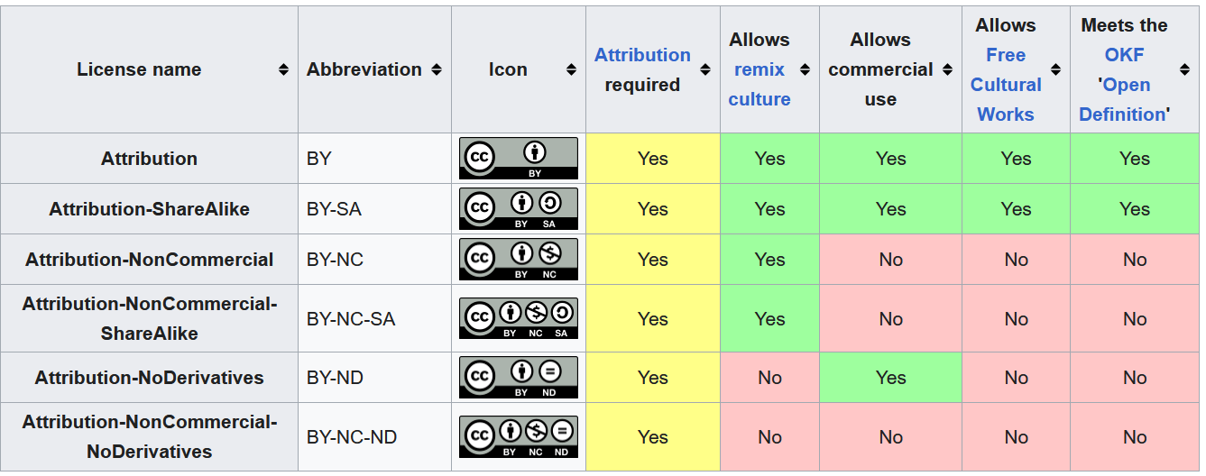
Creative Common Licences
Taken from Creative Commons license Wikipage (2023, December 15) in Wikipedia licensed under the Creative Commons Attribution-ShareAlike License 4.0 / cropped
A fact sheet on Creative Commons common concerns and OS produced by Foster can help you here.

Slide 45
Licenses advantages and limitations (example of the UK context)
OGL Good for UK public sector databases and datasets data to be used automatically Watch out for attribution stacking if used with differently licensed data categories of data that cannot be licensed in this way ties to the UK legal context | NCGL Good for commercially valuable UK public sector databases and datasets data to be used automatically Watch out for attribution stacking if used with differently licensed data restrictions on uses: only use with dual licensing categories of data that cannot be licensed in this way ties to the UK legal context | Public domain Good for most databases and datasets data to be used by anyone or any tool data to be used for any purpose Watch out for lack of control over how database is reused lack of protection against unfair competition
Source : https://www.dcc.ac.uk/guidance/how-guides/license-research-data#fn18x0

Slide 46
Licenses advantages and limitations (example of the UK context)
Creative Commons Good for very simple, factual datasets data to be used automatically Watch out for versions: use v. 4 or later attribution stacking the NC condition: only use with dual licensing the SA condition as it reduces interoperability the ND condition as it severely restricts reuse | ODC-By Good for most databases and datasets data to be used automatically data to be used for generating non-data products Watch out for attribution stacking | ODC-ODbL Good for most databases and datasets data to be used automatically data to be used for generating non-data products Watch out for attribution stacking the copyleft condition as it reduces interoperability the DRM clause as it may put off some reusers
Source : https://www.dcc.ac.uk/guidance/how-guides/license-research-data#fn18x0

Slide 47

What to do in practice before awarding a license?
content move to Unit 2
&
Reminders
Check List
The first thing to note is that only the rights holder (or someone with a right or licence to act on their behalf) can grant a license.
Check the legal status of your data - Is your data free of rights or subject to regulation?, ownership of the data ?
Check whether you are obliged or strongly encouraged to use a certain licence as a condition of funding or deposit, or as a matter of local policy.
Make sure you comply with the terms of the original license if your work is an adaptation or reuse.
If you chose a license that is not open on your data, make sure at least the licence on your metadata is open.
Remember : The choice of a license is a strategic legal act that commits the author of a work and conditions the future exploitation of this work.
A licence agreement can be applied to your data if you publish in a data repository
Repositories can be selected based on data license and sharing policy by using re3data.
Let’s see how it’s done in practice
Be careful when choosing your licence, once applied it will no longer be possible to change it
Sources : 1 - 2
Notes:
Show the trainee how they can check the sharing policy of some repository on re3data

Slide 48

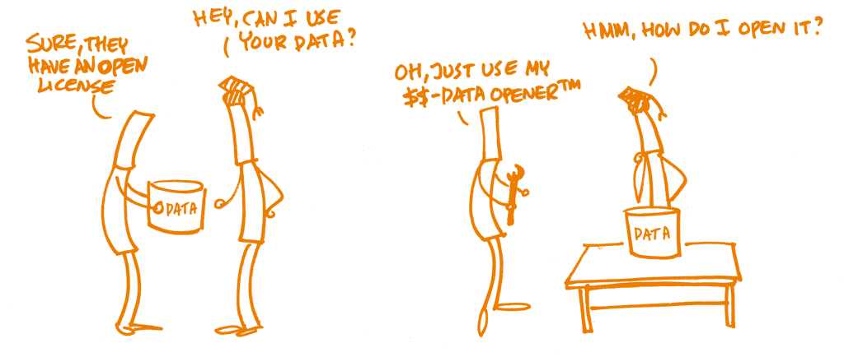
What to do in practice while awarding a license?
If you intend to reuse data, check under which terms and conditions the data is shared. Make sure that there is a licence, and that the licence gives you permission to do what you intend to. Without a licence, reusing a dataset could be setting you up for legal trouble.
Find the right licence for your research output. License Selector and Choose a license, tools can help you make a choice. To assign a Creative Common license, you can use License Chooser.
Keep it in mind ! If you choose an open license but do not choose an open file format, access might be restricted.
<image source : https://open-science-training-handbook.github.io/Open-Science-Training-Handbook_EN/02OpenScienceBasics/06OpenLicensingAndFileFormats.html CC0>

Slide 49
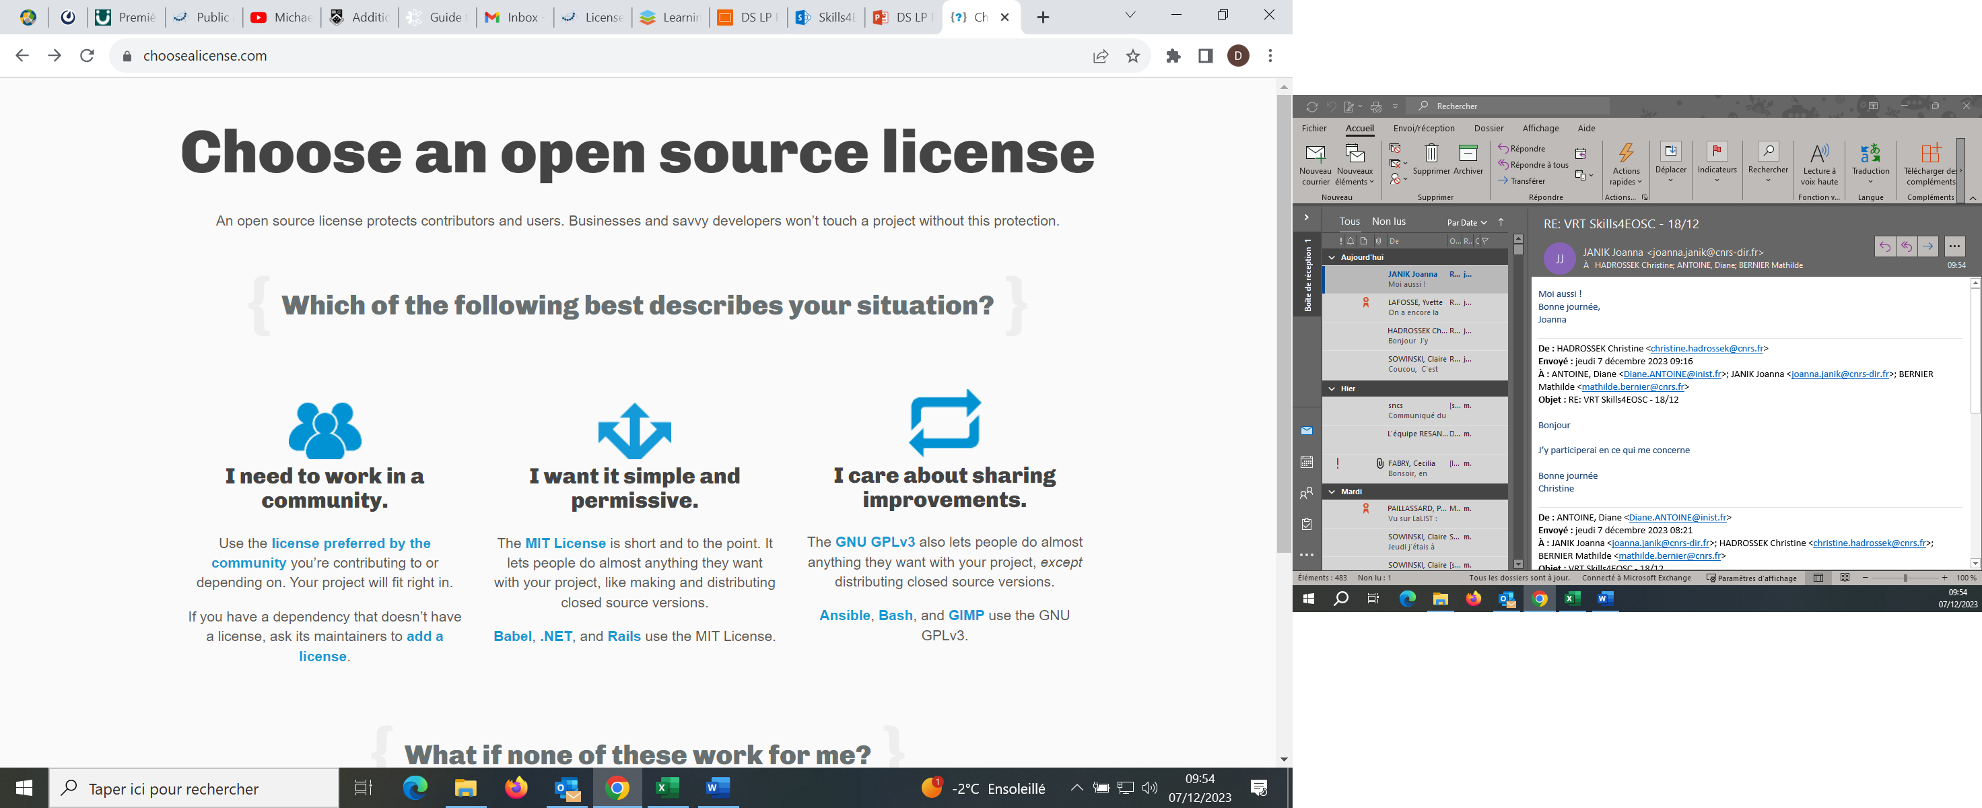
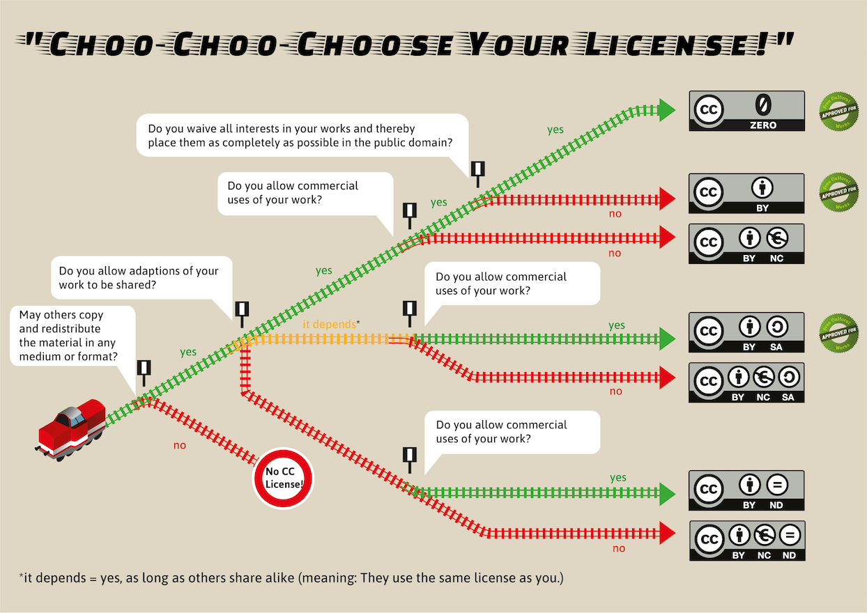
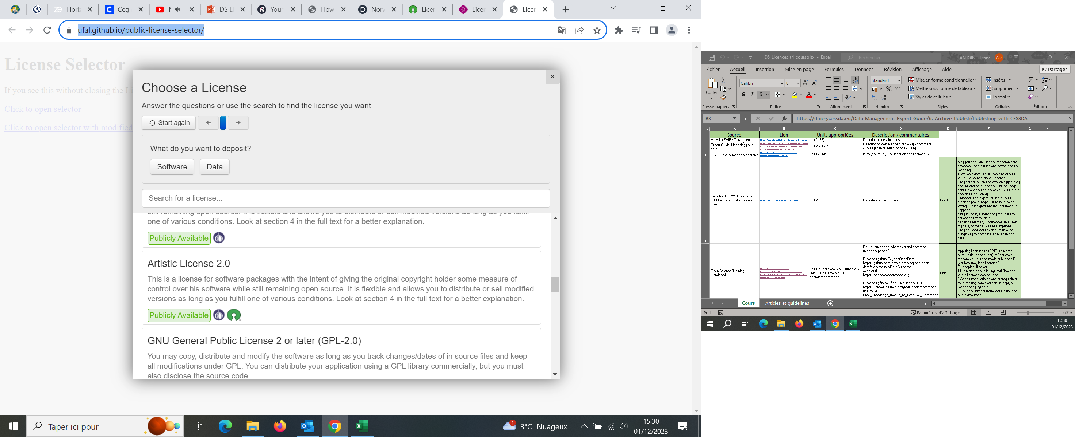
What to do in practice while awarding a license? –the tools- (1)
How to choose your CC license
Choose a license https://choosealicense.com/
Tools to guide you to your perfect license
Source : https://commons.wikimedia.org/wiki/File:Choo-Choo_choose_your_license_(Creative_Commons_License).png CC-BY SA
EUDAT licence selector wizard https://ufal.github.io/public-license-selector/

Slide 50
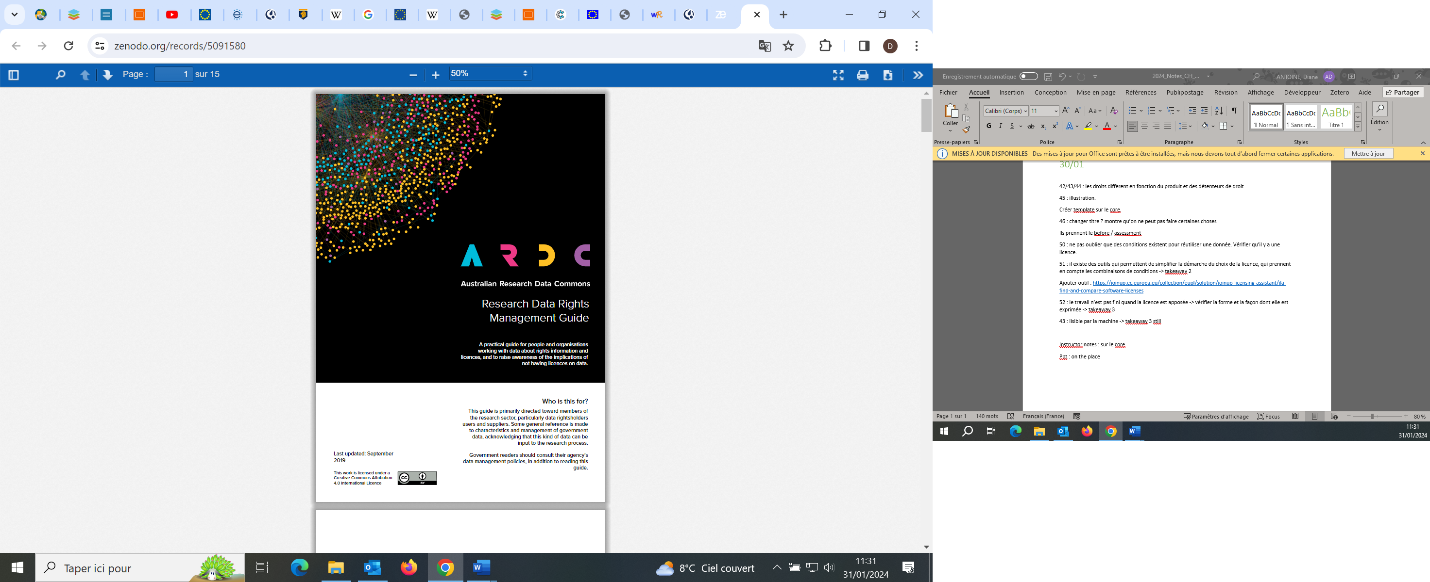
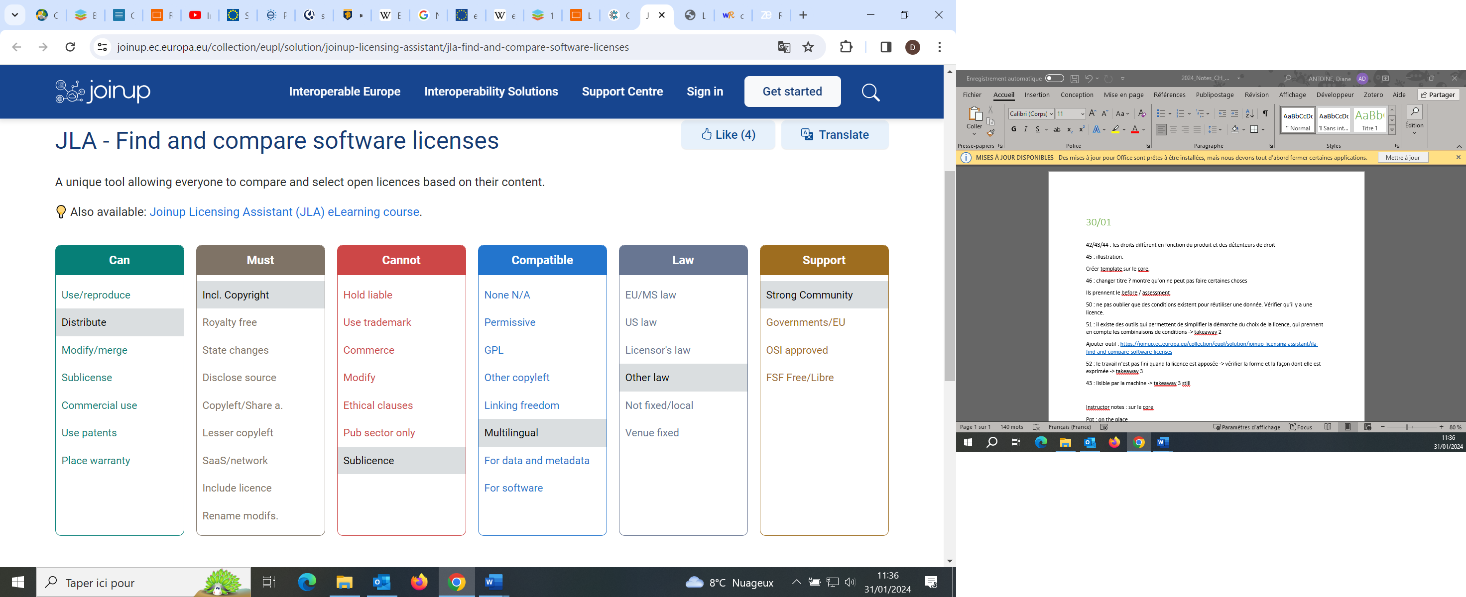

What to do in practice while awarding a license? –the tools- (2)
The Australian Research Data Commons (ARDC) published a guide on Rights Management that can help you choose your licence or reuse data https://ardc.edu.au/resource/research-data-rights-management-guide/ (CC-BY)
Research Data Rights guide
If your research output is a software, you can also use the Joinup Licensing Assistant
Tool for licensing software

Slide 51
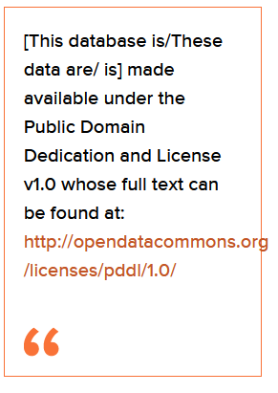
What to do in practice after awarding a license ?
It is also a good idea to ensure the rights statement is clearly displayed on pages from which the data may be downloaded
Check List
Once the license is applied on your data and on your metadata, check that those items are clarified :
Choose an open license
State the chosen license clearly and prominently
Explain the liberations/limitations of the chosen license, and what restrictions may apply
Let users know where they can find more information about this license
Explain that the license applies to the data, and not the content that the data represents (an open license on the metadata is not the same as the content itself being open, out of copyright, or able to be used freely)
Explain why this license was chosen
Example of a statement mentioning that the data is release under a particular licence and public domain dedication
<source : the Data Packaging Guide https://github.com/saverkamp/beyond-open-data/blob/master/DataGuide.md CC-BY>
<sources https://www.dcc.ac.uk/guidance/how-guides/license-research-data CC-BY

Slide 52
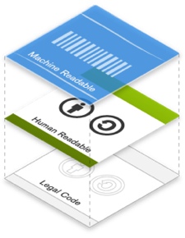
A minute about machine readability
Example of the Creative Commons license :
The rights statement should be displayed prominently, so that any user of the data will realise that they are licensed or public domain.
It is important to note, though, that the first inspection of the data might be done by an automated tool rather than a human.
The tool has to review the IPR status of a data source : this should be made available somewhere the tool would look when downloading the data.
When downloading data on a repository and chosing your license among those available, the machine-readability is directly handled by the repository.
If you use a CC licence and the CC licence chooser tool, it generates the HTML syntax that can be copied and embedded into web pages on the Internet. This syntax would not be visible to people browsing your web pages but can be read by search engines and in this sense, CC licenses are "machine-readable".
<img and text source : https://wikieducator.org/Creative_Commons_unplugged/Anatomy_of_a_CC_license & https://wikieducator.org/File:License-layers.png CC-BY>
<source : https://workplace.skills4eosc.eu/Products/Files/DocEditor.aspx?fileid=4543&action=view , CC-BY>

Slide 53
A minute about licensing metadata
Metadata helps people to discover your data.
The wider your metadata is distributed, the higher your visibility is.
Other may want to add to it, enhance it, link to other resources.
Good practices:
Licences for metadata should be as open as possible.
A public domain licence allows the widest reuse.
An attribution licence ensures you get credit downstream, but may cause problems if data is shared multiple times (attribution stacking).
Which licences are suited for metadata ?
Fully open reuse | Used but lead to attribution stacking (not ideal)
Public Domain Mark | CC-BY
CC0 | ODC-Attribution
PDDL | ISA Open Metadata licence 1.1
 | Open Government licence
NB : Other licences (non-commercial, non-derivatives, share-alike) are less suited; they make reuse of metadata for Linked Data applications difficult because they place restrictions on how metadata can be shared, used and enhanced.
<source : https://data.europa.eu/sites/default/files/d2.1.2_training_module_2.5_data_and_metadata_licensing_en_edp.pdf CC-BY>

Slide 54
Key takeaways
Research products are not equal in legal terms and require specific licenses. There are many different licenses available, each one having its own characteristics.
Your choice of licence partly depends on the nature of your research output. You need to identify the rights that apply to the different research outputs before awarding a licence.
There are some free online tools that can guide you towards finding the perfect licence considering your own needs and conditions.
Even when you have found the licence that perfectly match your needs, your work is not over just yet. You still have to check its readability :
- for humans : how your choice of licence is expressed when landing on your research output page;
- for machines : for interoperability.

Slide 55
Learning activity 3
Do you work with data or software research outputs? Go to choosealicense.com, and go through the different options for data and software licenses.

Slide 56
Individual Reflection
Based on today’s discussions about licensing:
What were you happy about learning today? (YES!)
Which good points are you taking with you? (AHA!)
A challenge or dilemma you need to consider (Hmmm)
What will you do differently from now on? (Go do!)

Slide 57
Summing up the learning path
Thank you for taking part!
Next steps – complete the homework and send it to us within 7 working days to receive your badge
Fill out the training evaluation form (ADD LINK)
Notes:
Engage in the research process and influence the research process to accommodate for more available and licensed data

Slide 58
Homework and certification
Thank you for your participation!
Send your completed learning activity sheet to your course partner for peer review. Has everyone exchanged emails?
After peer review, update your learning sheet and send it to the instructor at this mail: XXXX
Upon receipt you will receive your badge
Deadline for submission of updated learning sheet is 7 working days after the date the learning path was held

Slide 59
Works cited, further reading
Choosing a license for research data https://eprints.gla.ac.uk/171316/1/171316.pdf
Data and metadata licensing https://data.europa.eu/sites/default/files/d2.1.2_training_module_2.5_data_and_metadata_licensing_en_edp.pdf
Data management expert guide: Licensing your data: https://dmeg.cessda.eu/Data-Management-Expert-Guide/6.-Archive-Publish/Publishing-with-CESSDA-archives/Licensing-your-data/
Data Packaging Guide https://github.com/saverkamp/beyond-open-data/blob/master/DataGuide.md
Fact sheet on creative commons and open science https://www.fosteropenscience.eu/content/fact-sheet-creative-commons-open-science

Slide 60
Works cited, further reading
Foster Open Science training Handbook, chapter 6 “Open Licenses and file formats”: https://www.fosteropenscience.eu/content/open-science-training-handbook/
Graux, Hans; European Commission/Data Policy and Innovation 2023. Licence Compatibility in Europe: A winding road to Creative Commons. DOI: 10.2830/922544
Hansen, JS et al. 2021. Research Data Management Challenges in Citizen Science Projects and Recommendations for Library Support Services. A Scoping Review and Case Study. Data Science Journal, 20:25, pp. 1–29. DOI: https://doi.org/10.5334/dsj-2021-025
How to be FAIR with your data https://univerlag.uni-goettingen.de/bitstream/handle/3/isbn-978-3-86395-539-7/Engelhardt_FAIR.pdf?sequence=1&isAllowed=y

Slide 61
Works cited, further reading
How to FAIR: chapter “Data licenses”, from: Deutz, DB et al. 2020. How to FAIR: a Danish website to guide researchers on making research data more FAIR. https://doi.org/10.5281/zenodo.3712065
How to license research data https://www.dcc.ac.uk/guidance/how-guides/license-research-data#fn18x0
License compatability in Europe : https://data.europa.eu/sites/default/files/course/Licence%20compatibility%20in%20Europe%20a%20winding%20road%20to%20Creative%20Commons_EN.pdf
RDM kit: Why should you assign a license to your research data? https://rdmkit.elixir-europe.org/licensing
The Australian Research Data Commons (ARDC) also published a guide on Rights Management that can help you choose your licence or reuse data https://ardc.edu.au/resource/research-data-rights-management-guide/
Washington State Department of Licensing: Data Stewardship https://oercommons.org/courseware/lesson/94649/overview

Slide 62
Tools
License selector https://ufal.github.io/public-license-selector/
Choose a license https://choosealicense.com/
License chooser https://chooser-beta.creativecommons.org/

Slide 63
Parking space
The next slides are moved from elsewhere in the presentation.
The slides have been left in, beacuse they might provide more information you find useful in the context of your training

Slide 64

An open license? Waivers? Or something else? Communicating to potential output re-users
When a researcher licenses or waives a research output such as data, they are effectively communicating with (potential) output (re-)users
This is not so dissimilar from descriptive metadata: it says something meaningful about the output
Courtesan writing a letter. Kaigetsudo Doshin. ca. 1715 Public domain.

Slide 65
The nature of the output will help to determine the nature of the license
In the case of a dataset, one will have to consider the content of the dataset (does it contain sensitive data? does it require anonymization?)
Metadata, however, can always be openly licensed!
In the case of publications, the license will depend on the Open Access pathway taken

Slide 66

Thank you! Questions?

